Slide 1
Design and Analysis of Algorithm
UNIT-II
Greedy Algorithm
M Yogi Reddy
Assistant Professor,
Dept. of CSE,
School Of Technology,
GITAM(Deemed to be ) University,
Hyderabad.

Slide 2

Contents
Job Sequencing Algorithm
Knapsack Problem
Optimal storage on tapes [Huffman coding]
Minimum cost spanning trees
Single source shortest paths
1
2
3
4
5

Slide 3
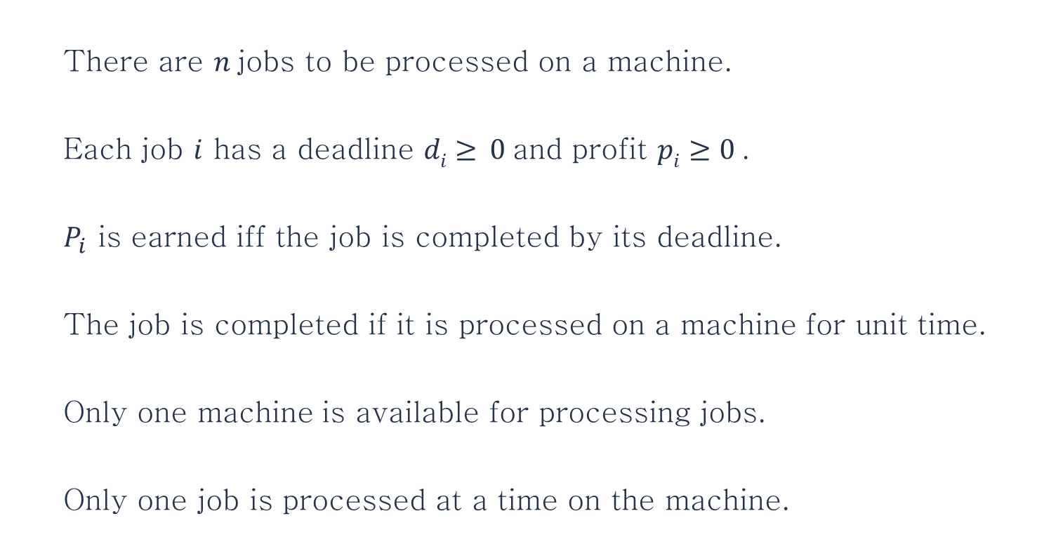
Job Sequencing With Deadlines
There are $n$jobs to be processed on a machine.
Each job $i$ has a deadline $di≥ 0$and profit $pi≥0$.
$P_{i}$ is earned iff the job is completed by its deadline.
The job is completed if it is processed on a machine for unit time.
Only one machine is available for processing jobs.
Only one job is processed at a time on the machine.
1
The problem is stated as follows.
2
3
4
5
6

Slide 4
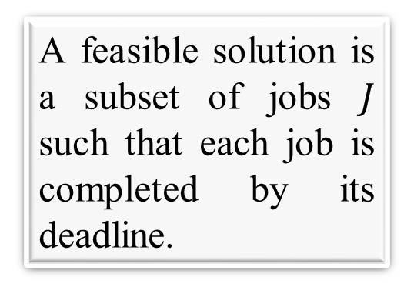
Job Sequencing With Deadlines
A feasible solution is a subset of jobs $J$ such that each job is completed by its deadline.
An optimal solution is a feasible solution with maximum profit value.
Example : Let n = 4, (p₁,p₂,p₃,p₄) = (100,10,15,27)
(d₁,d₂,d₃,d₄) = (2,1,2,1)

Slide 5
Job Sequencing With Deadlines
S. No, | Feasible Solution | Processing Sequence | Profit Value
1 | (1,2) | (2,1) | 110
2 | (1,3) | (1,3) or (3,1) | 115
3 | (1,4) | (4,1) | 127
4 | (2,3) | (2,3) | 25
5 | (3,4) | (4,3) | 42
6 | (1) | (1) | 100
7 | (2) | (2) | 10
8 | (3) | (3) | 15
9 | (4) | (4) | 27

Slide 6
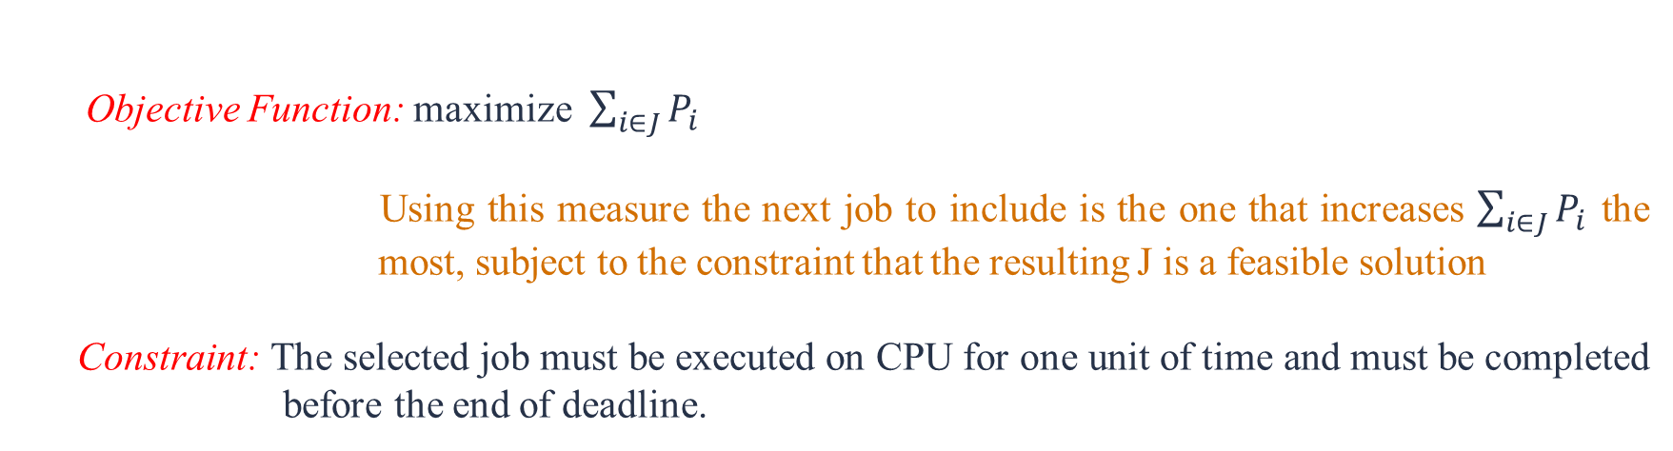
Job Sequencing With Deadlines
To formulate a greedy algorithm to obtain an optimal solution, we must formulate an optimization measure to determine how the next job is chosen.
Objective Function: maximize $\sum_{i∈J}{P_{i}}$
Using this measure the next job to include is the one that increases $\sum_{i∈J}{P_{i}}$ the most, subject to the constraint that the resulting J is a feasible solution
Constraint: The selected job must be executed on CPU for one unit of time and must be completed before the end of deadline.

Slide 7

Example
Example : Let n = 4, $(p1, p2, p3, p4) = (100,10,15,27)$
$(d1,d2,d3,d4) = (2, 1, 2, 1)$
 | $$P_{1}$$
$$P_{4}$$ | $$P_{1}$$
1 2 3 4
Optimal Solution ($P_{4} , P_{1}$)

Slide 8
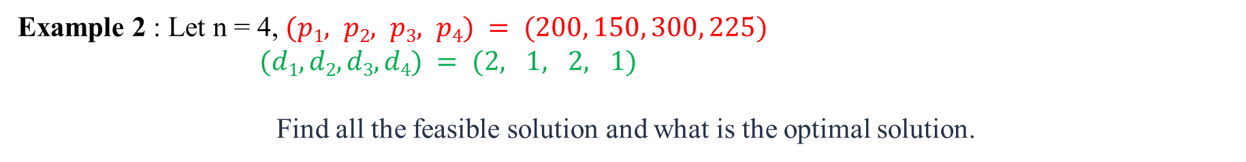
Question
Example 2 : Let n = 4, $(p1, p2, p3, p4) = (200, 150, 300, 225)$
$(d1,d2,d3,d4) = (2, 1, 2, 1)$
Find all the feasible solution and what is the optimal solution.
Feasible Solution:
{$J_{1}$} {$J_{2}$} {$J_{3}$} {$J_{4}$} {$J_{2}$, $J_{1}$} {$J_{2}, J_{3}$} {${J_{4}, J}_{1}$} {$J_{1}, J_{3}$} or {$J_{3}, J_{1}$} {$J_{4}, J_{3}$}
200 150 300 225 350 450 425 500 525
Optimal Solution:
 | $$P_{3}$$
$$P_{4}$$ | $$P_{3}$$
1 2 3 4

Slide 9
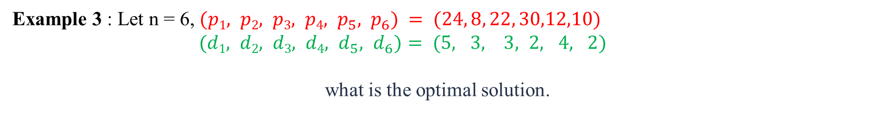
Question
Example 3 : Let n = 6, $(p1, p2, p3, p4, p_{5}, p_{6}) = (24, 8, 22, 30,12,10)$
$(d1, d2, d3, d4, d_{5}, d_{6})= (5, 3, 3, 2, 4, 2)$
what is the optimal solution.
Optimal Solution:
 | $$J_{4}$$
 | $$J_{4}$$ | $$J_{3}$$ |  | $$J_{1}$$
 | $$J_{4}$$ | $$J_{3}$$ | $$J_{5}$$ | $$J_{1}$$
$$J_{6}$$ | $$J_{4}$$ | $$J_{3}$$ | $$J_{5}$$ | $$J_{1}$$
 | $$J_{4}$$ |  |  | $$J_{1}$$
1 2 3 4 5 6

Slide 10
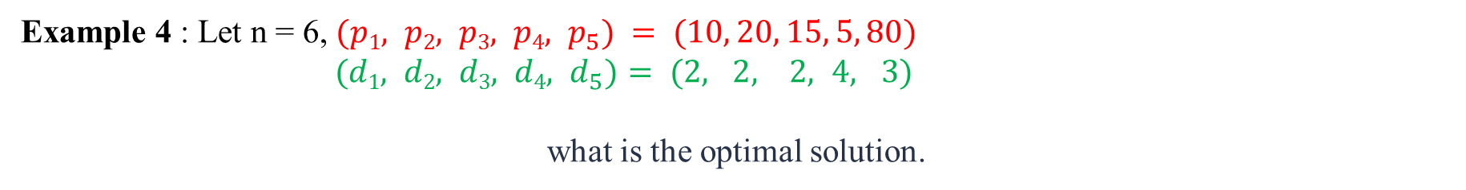
Question
Example 4 : Let n = 6, $(p1, p2, p3, p4, p_{5}) = (10, 20, 15, 5, 80)$
$(d1, d2, d3, d4, d_{5})= (2, 2, 2, 4, 3)$
what is the optimal solution.
Optimal Solution:
$$J_{2}$$ | $$J_{3}$$ | $$J_{5}$$ | $$J_{4}$$
1 2 3 4 5

Slide 11
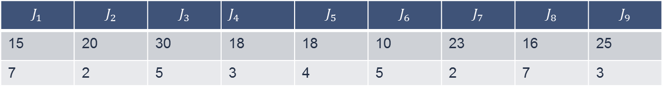
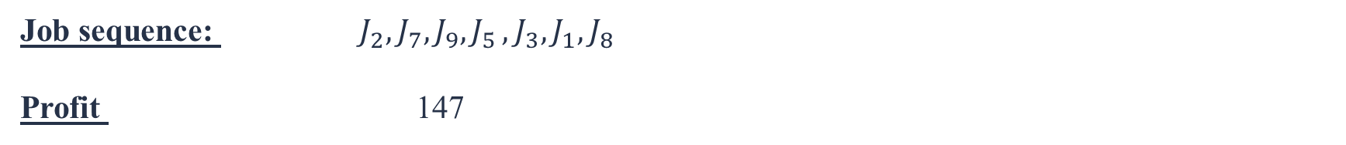
Question
Example 5 : Let n = 9,
what is the Maximum Profit.
$$J_{1}$$ | $$J_{2}$$ | $$J_{3}$$ | $J_{4}$ | $$J_{5}$$ | $$J_{6}$$ | $$J_{7}$$ | $$J_{8}$$ | $$J_{9}$$
15 | 20 | 30 | 18 | 18 | 10 | 23 | 16 | 25
7 | 2 | 5 | 3 | 4 | 5 | 2 | 7 | 3
Job sequence: $J_{2},J_{7},J_{9}{, J}_{5},J_{3}, J_{1}, J_{8}$
Profit 147

Slide 12
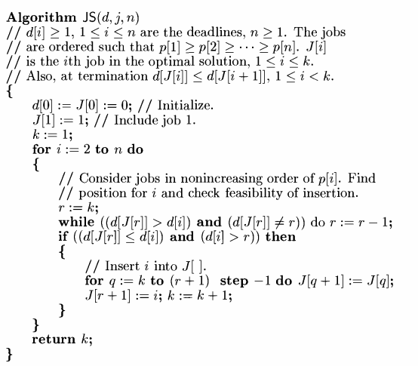
Algorithm

Slide 13
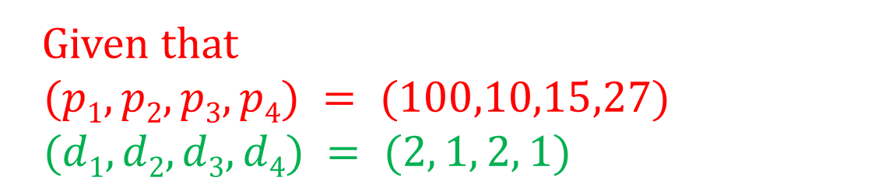
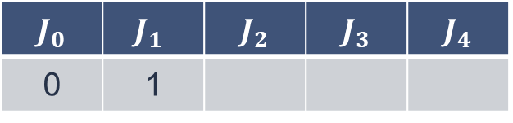
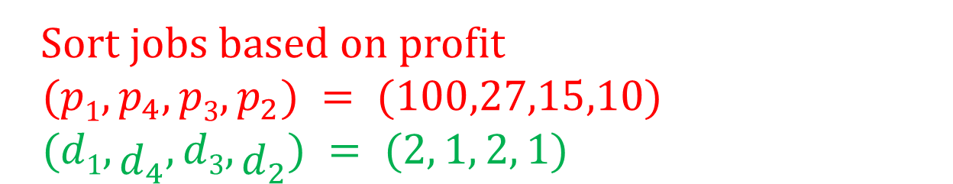
Algorithm
Given that
$(p1, p2, p3, p4) = (100,10,15,27)$
$(d1,d2,d3,d4) = (2, 1, 2, 1)$
Sort jobs based on profit
$(p1, p_{4}, p3, p_{2}) = (100,27,15,10)$
$(d1,d_{4},d3,d_{2}) = (2, 1, 2, 1)$
Initialize
$$J_{0}$$ | $$J_{1}$$ | $$J_{2}$$ | $$J_{3}$$ | $$J_{4}$$
0 | 1

Slide 14
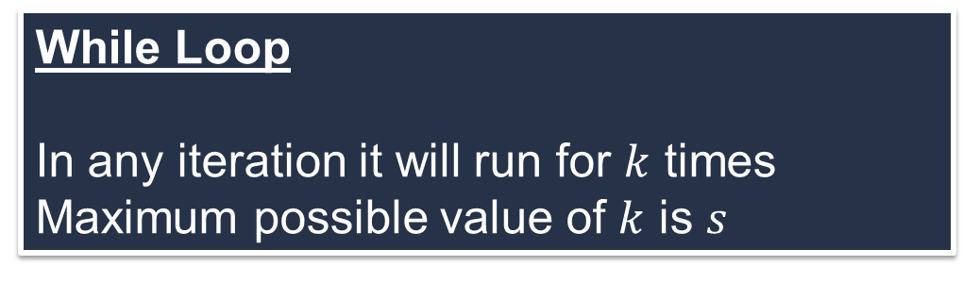
Complexity of the algorithm
For the given algorithm there are two parameters in terms of which its complexity can be measured.
Total number of jobs (say n)
Number of jobs selected (say s)
There are two loops (1) For loop (2) While loop
For Loop
It will run maximum of n-1 times, So complexity is o(n)
While Loop
In any iteration it will run for $k$ times
Maximum possible value of $k$ is $s$
The complexity of the given algorithm will thus be O(ns)

Slide 15



